Slide 1
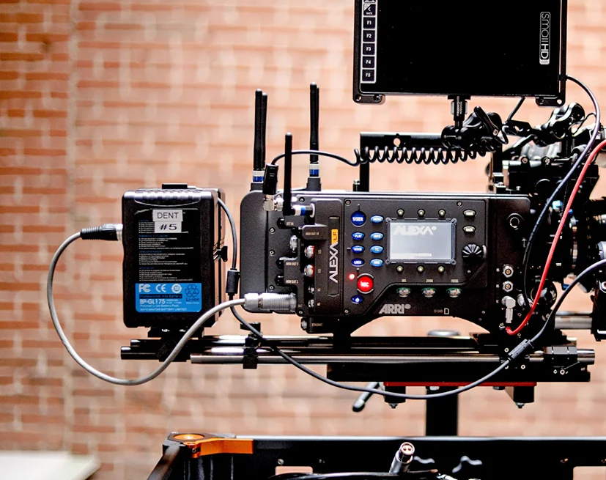
Rates adjustment system
Presented by: Christian van Zyl
Date: 28/ 11/ 2022

Slide 2
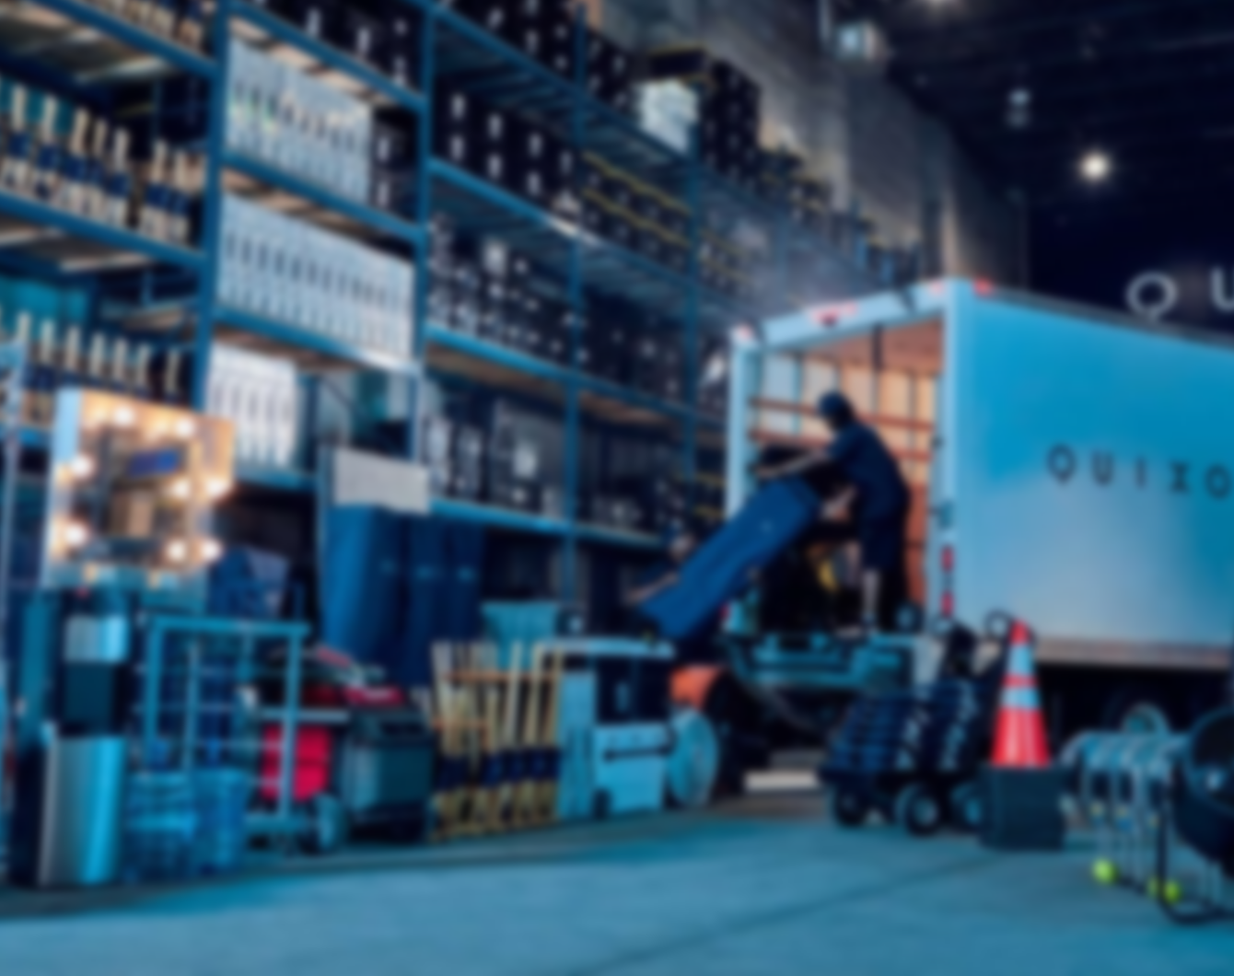
Domain
Filming industry
Film rental house
Renting of camera equipment used on film sets/advertisements etc.

Slide 3
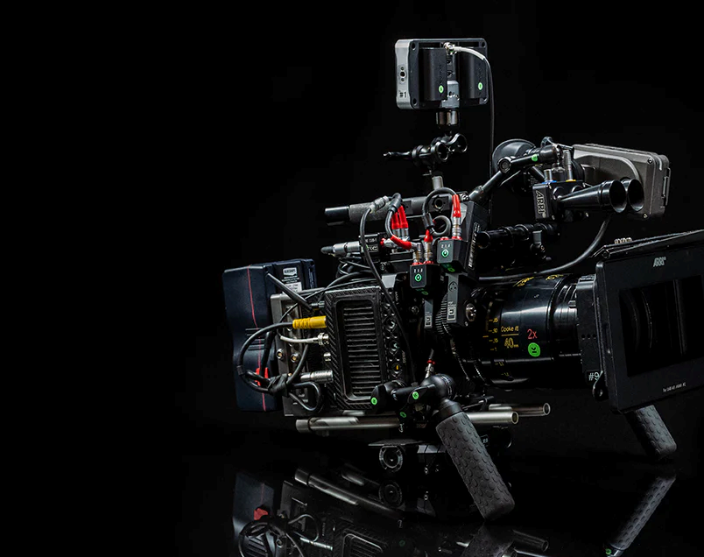
Client
Smaller rental house
Provides camera gear for hire
Competitive advantage:
Cheaper rates than bigger rental houses
Offers pre-packaged kits with a discount

Slide 4
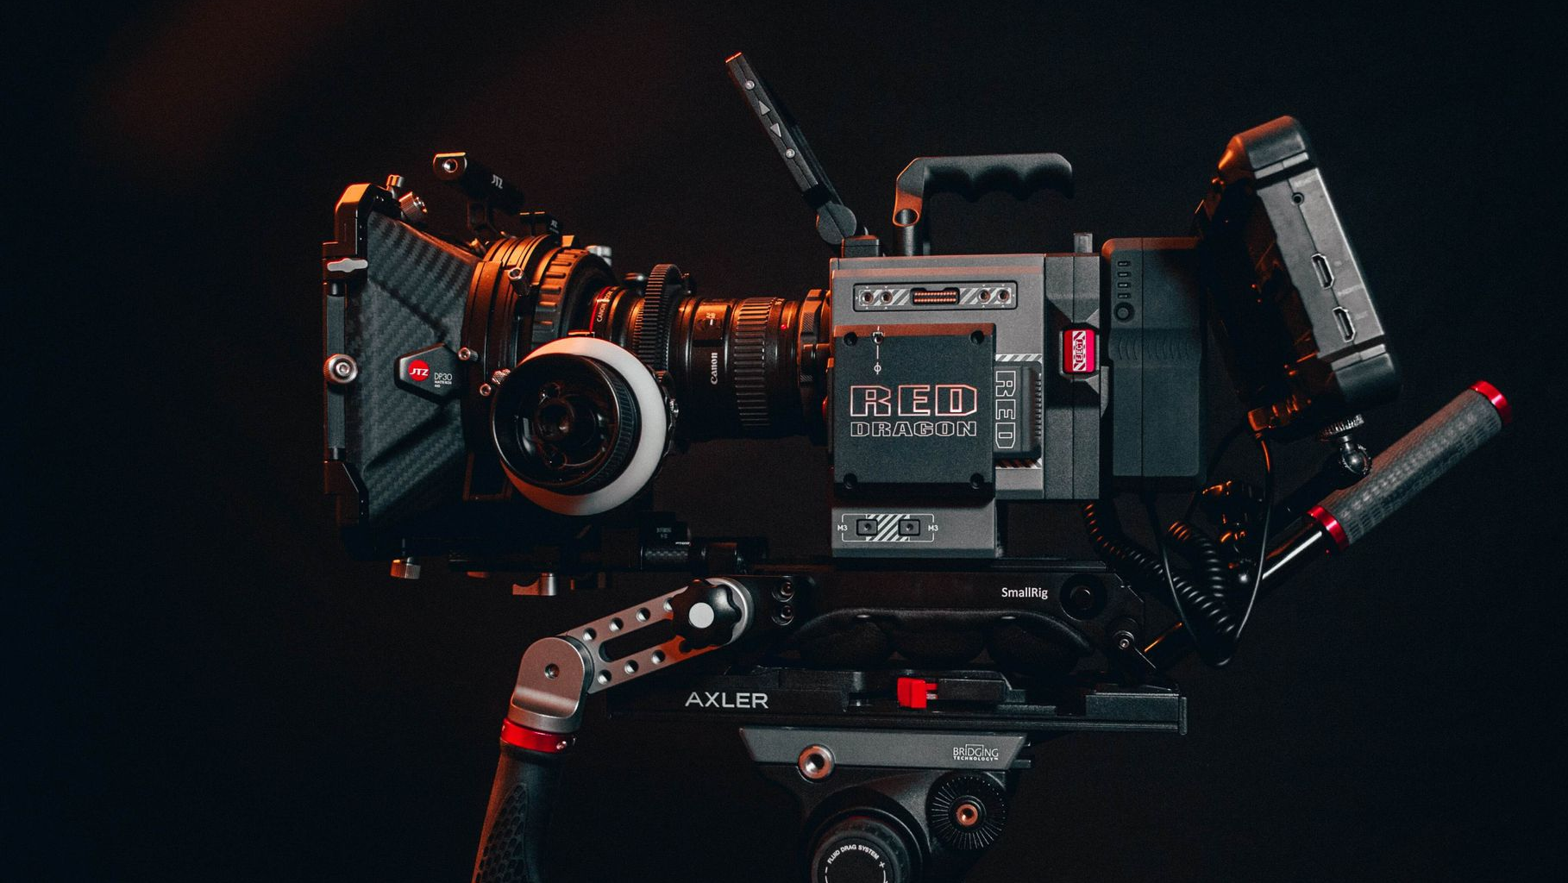
Problem statement
Competitive advantages difficult to manage.
Reason – current economic instability and COVID pandemic after-effects leads to constant adjustment of rates on gear and discount offered on kits – need to be cheaper than competitors, but still make profit.
Sizeable amount of gear to reprocess. Manual adjustment of rates and recalculation of kit rates susceptible to human error.

Slide 5
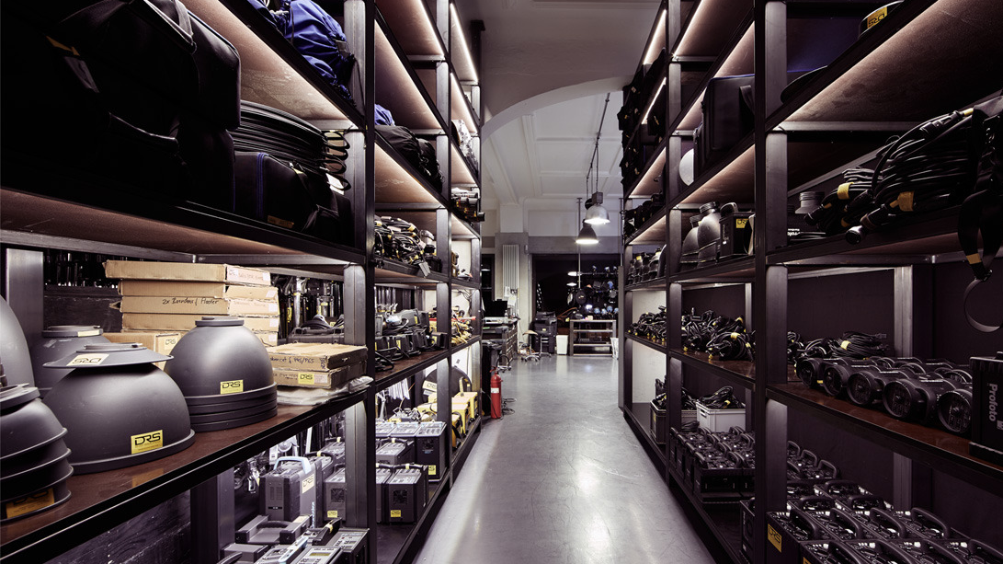
Solution
System that can automate the adjustment of rates and discount offered on kits.

Slide 6
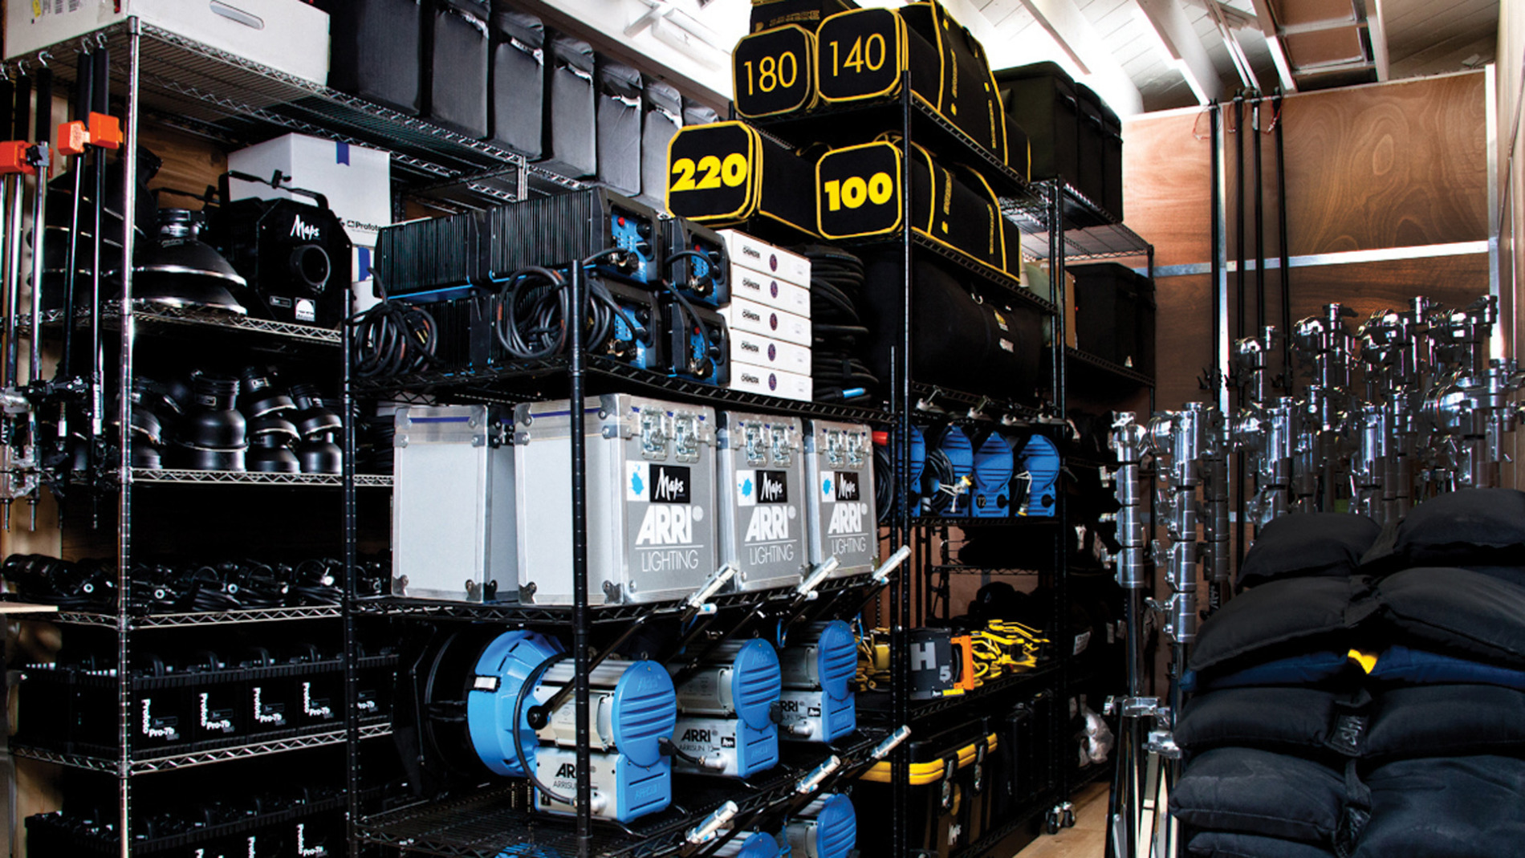
Basic Terminology

Slide 7
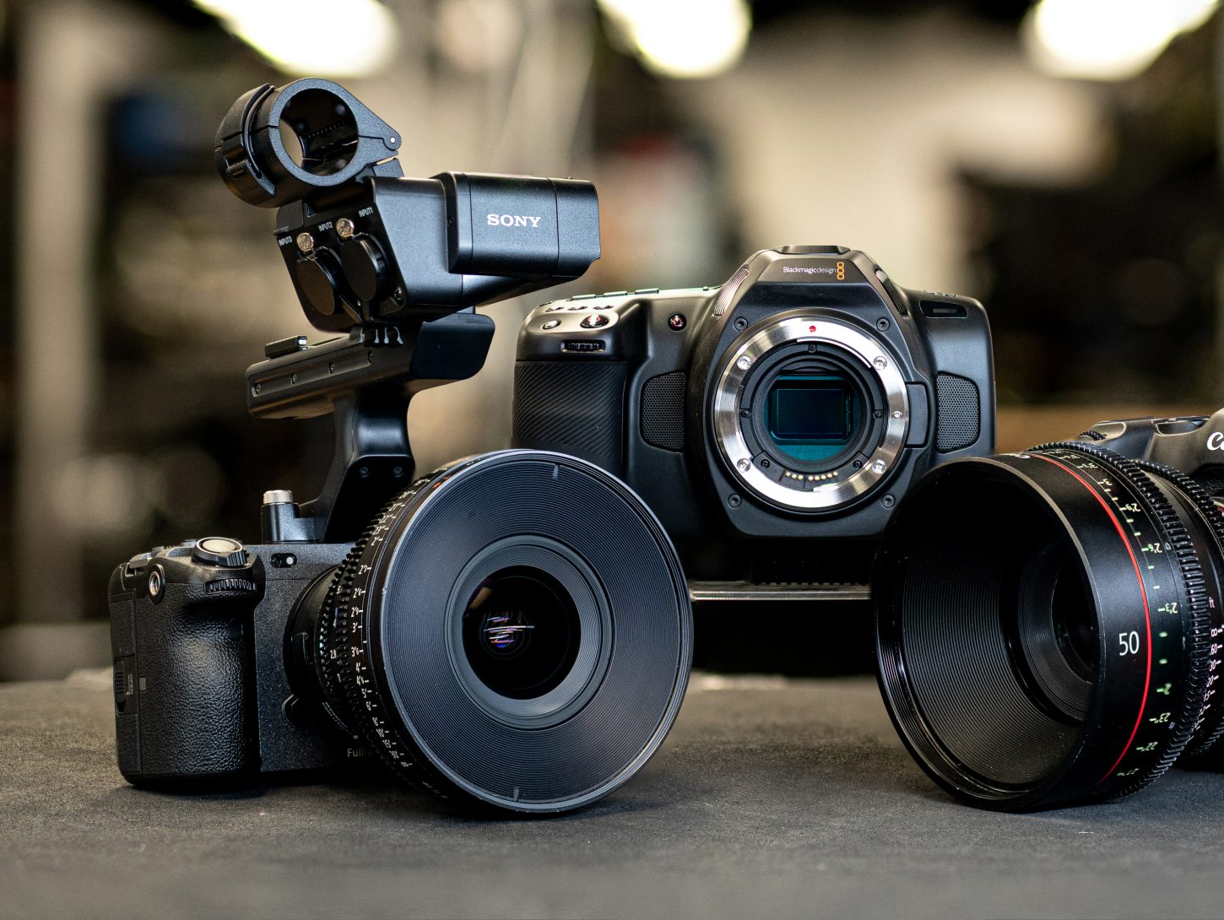
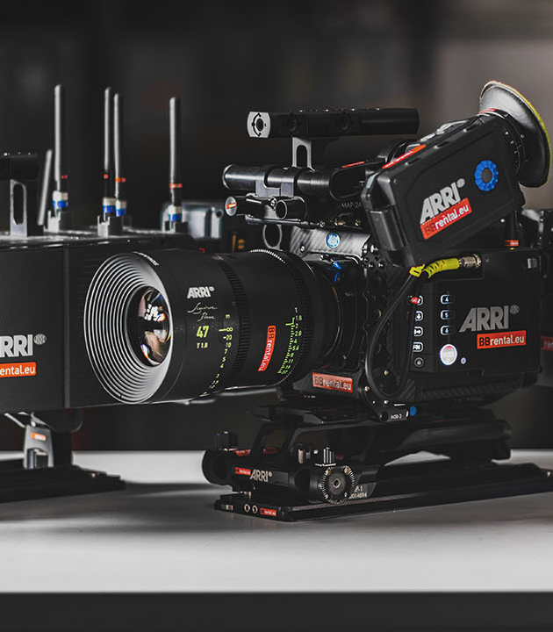
Camera
Two types of sensors:
Full-frame
Cropped
Dynamic range:
Ratio between pure black and brightest white in an image

Slide 8
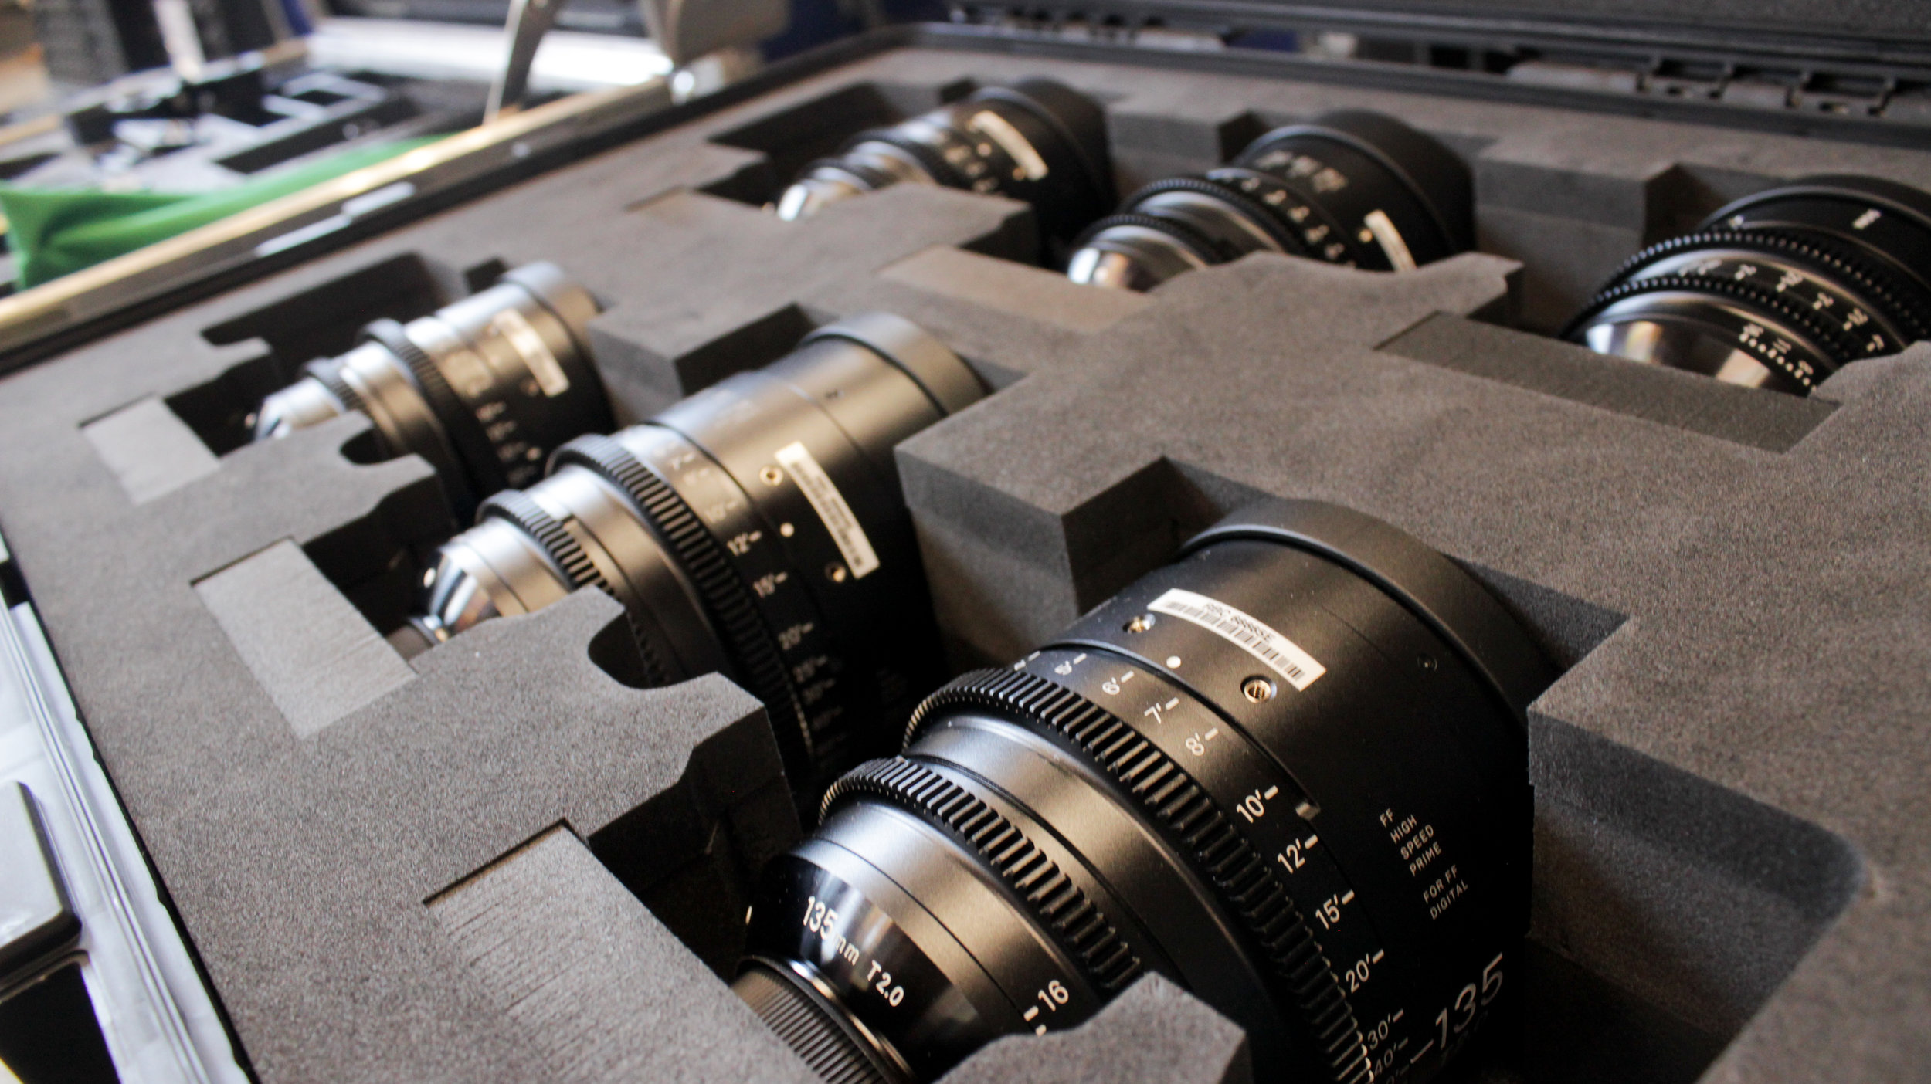
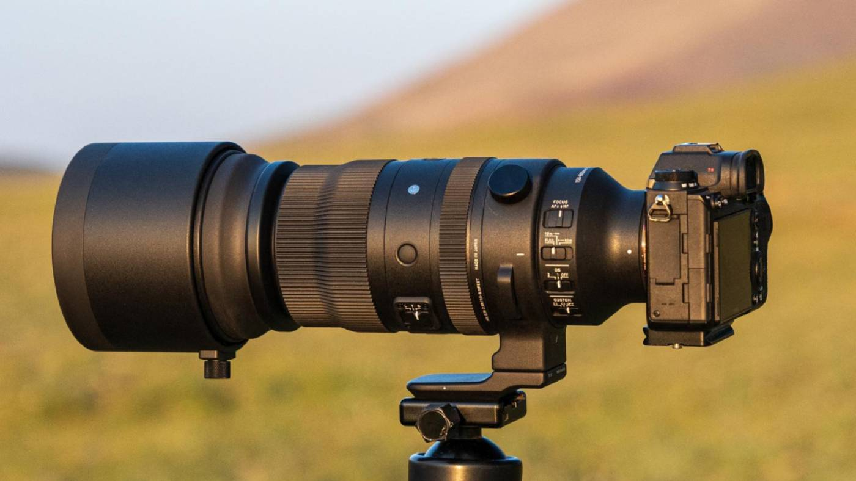
Lenses
Two types of lenses:
Prime (fixed focal-length)
Zoom (variable focal-length)

Slide 9
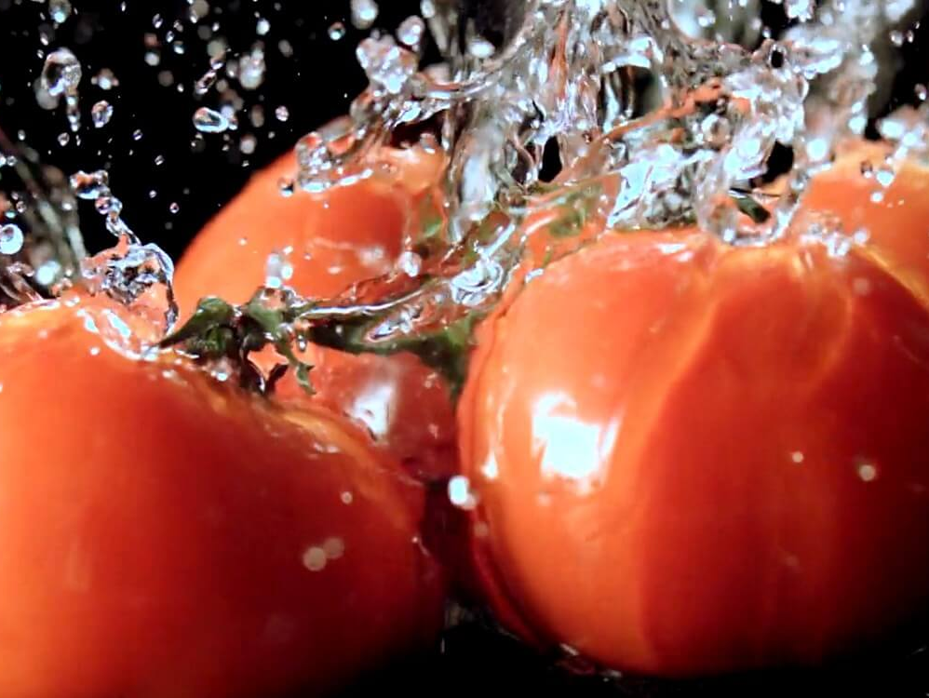
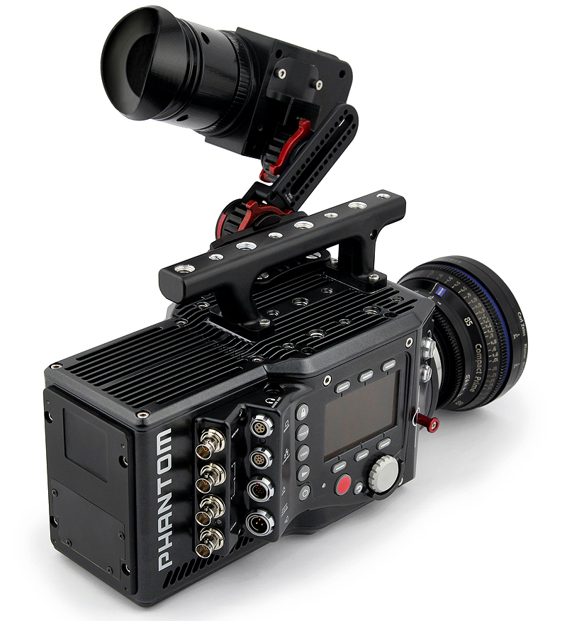
High Speed Camera
Frames per second: Higher frames, greater amount that can be slowed down
Workflow-solution: Camera data cannot be extracted without specialized, brand-specific equipment

Slide 10
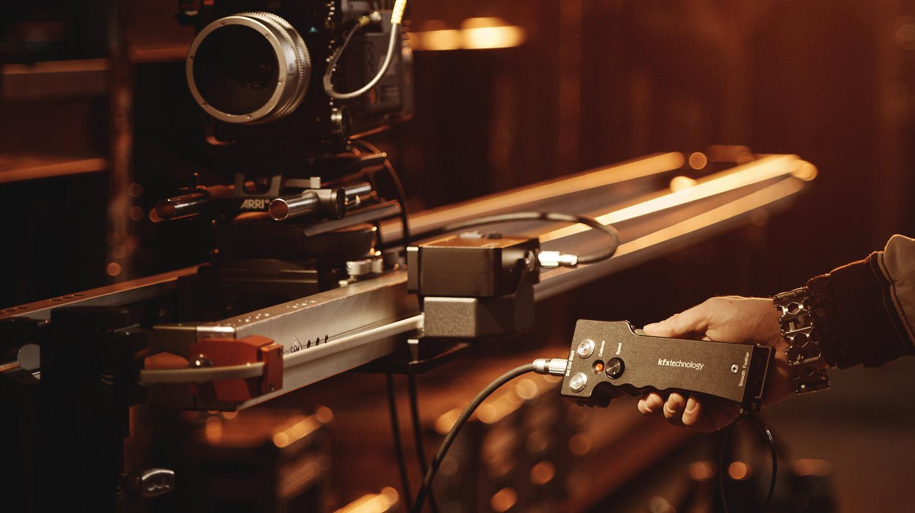
Domain Classes

Slide 11
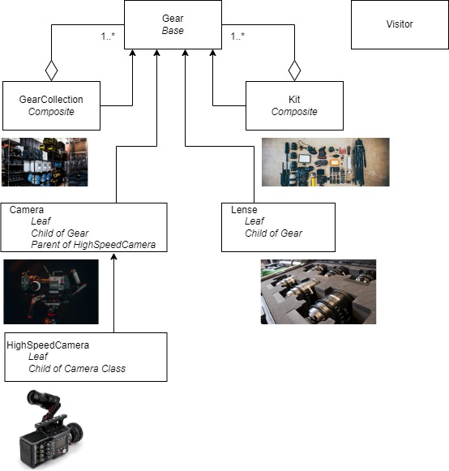

Slide 12
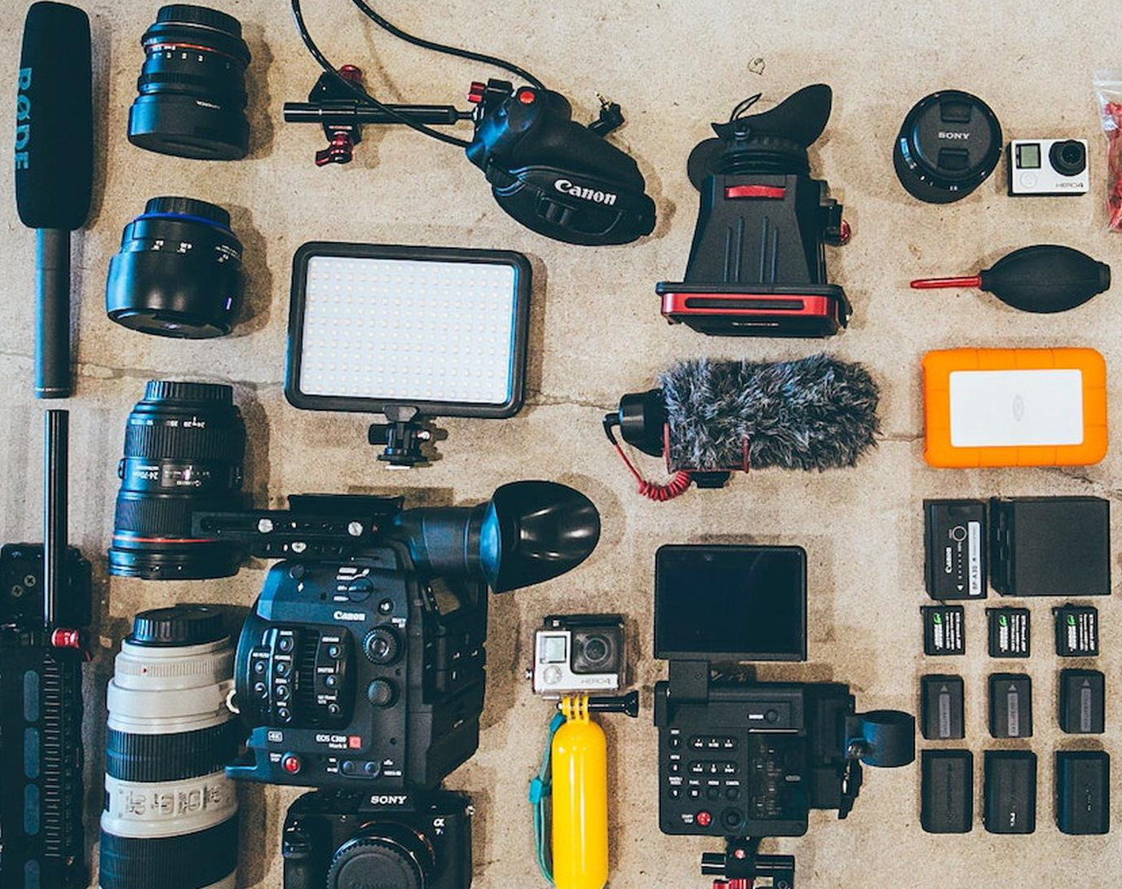
Code Demonstration

